Slide 1
How to Read your Paycheck
Presenters –
Stephanie Rowe, CPA - LRCFT Treasurer
Rebecca Goodchild – SCC LRCFT President
Brandy Shiners – Payroll Analyst

Slide 2

Agenda
Overview
Full-time paycheck
Part-time paycheck
HR & Payroll Contacts
Questions

Slide 3

Overview
What details are included on your paycheck​
Your paycheck includes:
- your salary/rate
- income tax selections
- deductions (pre- and after tax)
- district-paid benefits
- sick time
What details are not included on your paycheck
It does not show your step and class!
That information is available on eServices/Employee Information​
Then you compare that to the salary schedules available on www.losrios.edu – HR benefits/salary schedules

Slide 4
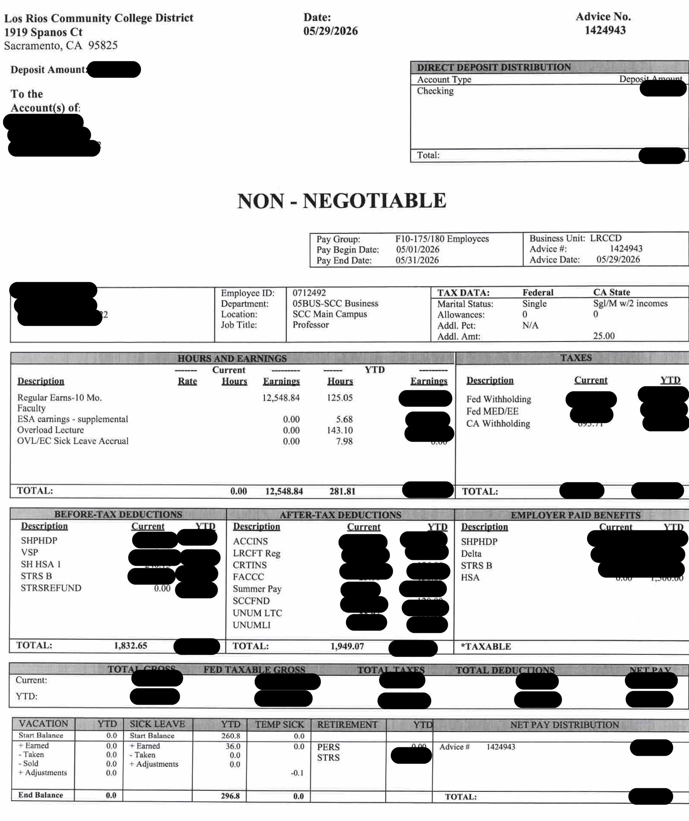
Let’s review a full-time paycheck
Items to note:
Tax Data section
Hours and Earnings section
Before-Tax Deductions
After-Tax Deductions
Sick Leave section

Slide 5
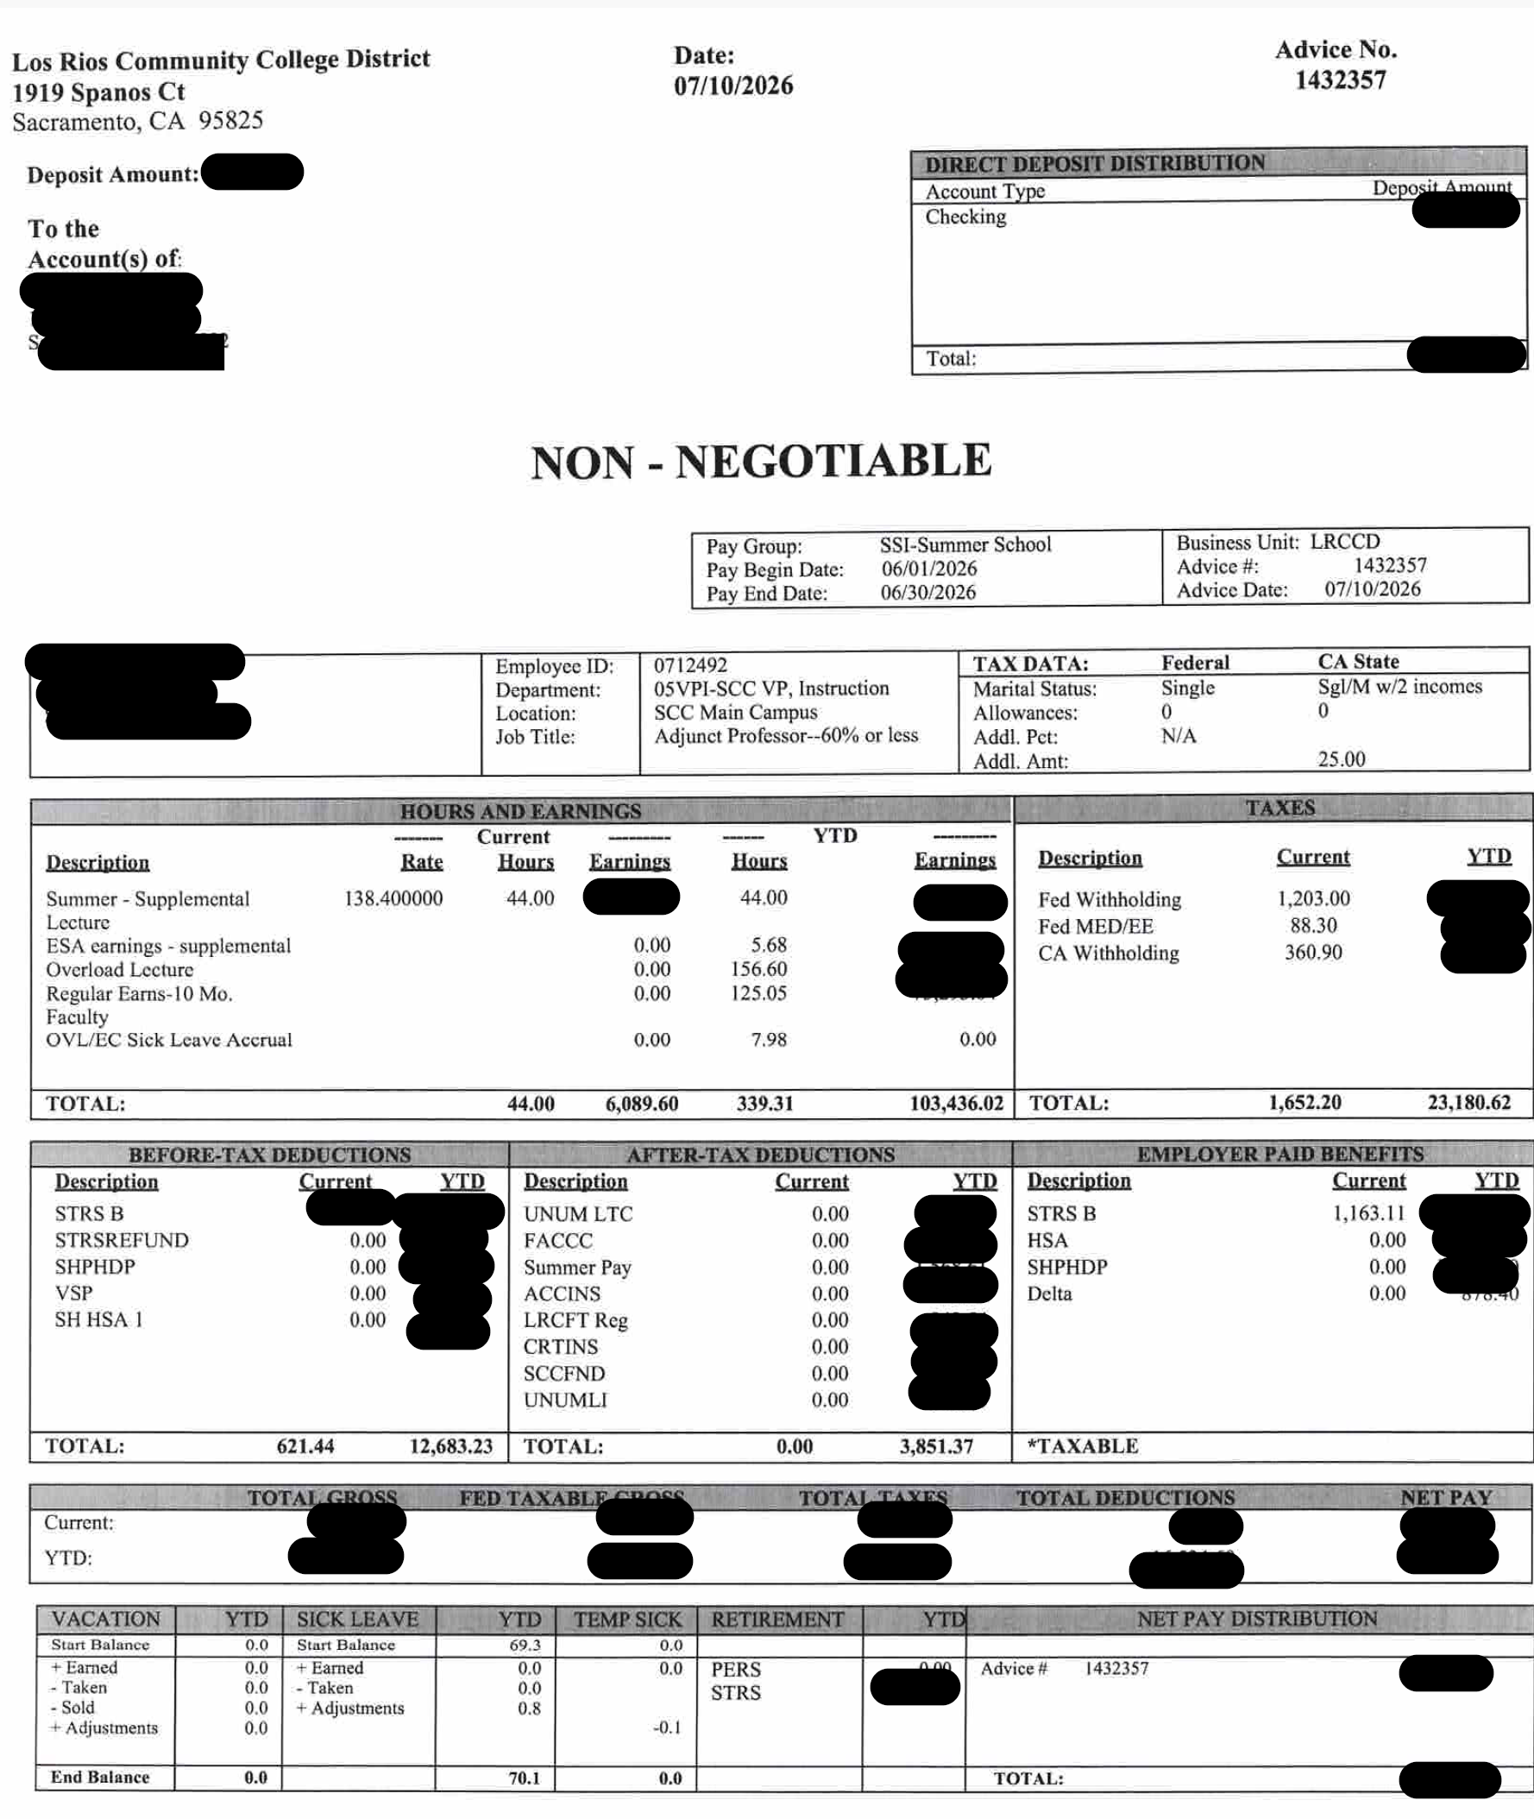
Let’s review a part-time paycheck
Items to note:
Tax Data section
Hours and Earnings section
Before-Tax Deductions
After-Tax Deductions
Sick Leave section

Slide 6
HR & Payroll contacts
HR contacts – Updates located on losrios.edu/HR
HR Director – Ashley Reyes reyesa3@losrios.edu
HR Specialist (FT last names A to K) – TBD
HR Specialist (FT last names L to Z) – Janey Yang yangj3@losrios.edu
HR Specialist (ADJ/OVL last names A to F) – Clarisa Carrillo carrilc2@losrios.edu
HR Specialist (ADJ/OVL last names G to M) – Maribel Gaytan gaytanm@losrios.edu
HR Specialist (ADJ/OVL last names N to Z) – Riddi Topiwala topiwar@losrios.edu
Payroll contacts
Payroll Supervisor – Lori Chou choul@losrios.edu
Payroll Email – dopayroll@losrios.edu
Union contacts
Stephanie Rowe, Treasurer – stephanie@lrcft.org
Rebecca Goodchild, SCC President – goodchr@scc.losrios.edu

Slide 7

Any Questions??

