Slide 1
How Not to Lose Pay: Leaves (Sick Days, Personal Business, Personal Necessity)
10/26/23 via Zoom
Presented by
Bill Miller
Michael Henderson

Slide 2
I. Poll about absence reports
When you are or will be absent, faculty are required to notify their Dean.
If you were to have an absence, who would fill out your absence report in Employee Self Service?
Me
My Dean and Administrative Assistant
I don’t know
Notes:
Image from - https://www.pexels.com/photo/woman-working-at-home-9869377/ free to use

Slide 3
Your LRCFT Team
LRCFT OFFICERS
Jason Newman, President, newmanj@crc.losrios.edu
Stephanie Rowe, Treasurer, rowes@scc.losrios.edu
Belinda Lum, Chief Negotiations Officer, lumb@scc.losrios.edu
SACRAMENTO CITY COLLEGE
Belinda Lum, College President, lumb@scc.losrios.edu
Kathleen Carbary, College Rep, carbark@scc.losrios.edu
Joe Farrelly, Adjunct Rep, FarrelJ@scc.losrios.edu
Rebecca Goodchild, College Rep, goodchr@scc.losrios.edu
Jacqueline Vargas-Oñate, College Rep, vargasj@scc.losrios.edu
LRCFT STAFF
Michael Henderson, Executive Director, mhenderson@lrcft.org
Reina Mayorga, Office/Database Manager. reina@lrcft.org
Email your LRCFT Team with questions about today’s presentation or any workplace condition!
Notes:
Section 8.1 of 23-26 contract

Slide 4
Overview:
Poll about absence reports
How do I know how much of each leave I have?
General Conditions for all paid leaves
Specifics about each type of leave
Sick Leave
Personal Necessity
Personal Business
Other things about these leaves

Slide 5
II. How do I know how much of each leave I have?
Sick Leave: see the bottom of your pay stub

Slide 6
II. How do I know how much of each leave I have?
Note, for faculty with multiple banks of sick leave, the check stub you review will have your balance for that assignment. A full-time check stub will show a full-time sick leave balance, an overload check stub will show overload sick leave and a summer school check will show a summer school balance.

Slide 7
II. How do I know how much of each leave I have?
Personal Necessity Leave: Article 9.4.1.1: Six (6) days of accrued sick leave may be used during any fiscal year by the employee in cases of personal necessity.
Who has it? Tenured/Tenure Track, LTT, and Adjunct
A way to use sick time for other purposes than you being sick
(however, if you don't have ay sick time, then you don't have any Personal Necessity time either)

Slide 8
II. How do I know how much of each leave I have?
Personal Business Leave: Article 9.9.1: Each full-time contract/regular employee may be granted a maximum of two (2) days per academic year. Unused personal business days do not accrue or carry over from one year to the next.
Who gets it? Tenured/Tenure Track
Not from sick time. Use it or lose it.
When can I use it: Fall or Spring (not summer)

Slide 9
III. General Conditions for all paid leaves
(Article 9.2)
Must notify appropriate Area Dean
Documentation can be required for any absence.
Documentation is required for any absence in excess of 10 days
Gainful employment disallowed while on paid leave

Slide 10
IVA. Specifics about sick leave
(Article 9.3)
9.3: May charge absences due to mental health, mental illness, physical illness, and physical injury
9.3.7: May bring sick leave you earned from other CA public school districts to Los Rios

Slide 11
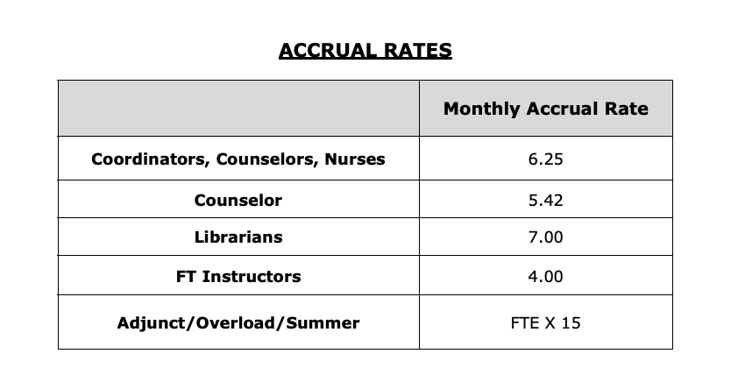
IVA. Specifics about sick leave
Ten-month FT employees earn 10 days/year, 1 day per month.
Adjunct/PT employees earn sick time in proportion to the ratio of their work hours to FT employment

Slide 12
IVB. Specifics about personal necessity leave
9.4.1.1: Six days of sick leave may be used during any fiscal year including summer.
9.4.1.3: Whenever possible, must be submitted and approved in advance (e.g., religious observances of the employee’s faith)
9.4.1.4: Advance approval not required: death or illness of immediate family members, accident involving person or property of employee or immediate family member, imminent danger of employee or immediate family member

Slide 13
IVB. Specifics about personal necessity leave
9.4.1.5 Additional uses of Personal Necessity leave:
To supplement Critical Illness, Judicial Appearance, and Bereavement Leaves

Slide 14
So, who is "an immediate family member?"
9.1.4: Immediate family includes mother, father, grandparent or grandchild of the employee or of the employee's spouse or domestic partner; and step-mother, stepfather, spouse, domestic partner, son, son-in-law, step-son, daughter, daughter-in-law, step-daughter; brother, brother-in-law, sister, sister-in-law, aunt, uncle; child or sibling of domestic partner; wife or husband of domestic partner's child.

Slide 15
So, who is "an immediate family member?"
In addition, immediate family also includes a designated person of the employee, as defined by Gov Code 12945.2. A designated person will be identified at the time the leave is requested and is limited to one person per twelve (12) month period.

Slide 16
So, who is NOT "an immediate family member?"
Unless they are your designated person:*
nephews/nieces, best friend, cousins, etc.
* "designated person" also plays a role in Bereavement, Critical Illness, and Catastrophic Leave

Slide 17
IVB. Specifics about personal business leave
9.9.1 Tenured/Tenure Track (not LTT) employees only
Two days per calendar year usable during fall and spring semesters only (both can be used in one semester)
Can be used for: personal care, child's school/meeting, scheduled home repair, legal appointment, or meeting with tax preparer

Slide 18
IVB. Specifics about personal business leave
"It is required that the appropriate administrator be advised that Personal Business Leave will be taken. Advance notification is expected except under extenuating circumstances."
There is no documentation requirement. There is no approval needed.
You assume the responsibility to meet all professional obligations including presenting material missed as a result of the absence. No subs!

Slide 19
IVB. Specifics about personal business leave
Example of notifying administrator: "Dear Dean Horton, I will be Personal Business leave on December 1st for personal care. I assume responsibility for meeting all professional obligations.
Regards, Bill"

Slide 20
V. Other things about these leaves
Before you take a leave, check to see if you have time in the correct Fall/Spring, Overload/Adjunct, and Summer leave bank. If you don't have the leave, you can lose pay.
How do you check your PN/PB time? Go into Employee Self Service → Absence Reporting → Absence Time History and input a date range to see all your absences. No absences reported means you have your full allotment.

Slide 21
V. Other things about these leaves
2.6.3.2: If you lose more than 3 days of pay per academic year, then you will not advance a step on the salary schedule that year (may advance at mid-year).
If you use sick or personal necessity leave, you are not responsible for finding a sub. It may be in your best interest, but … not your job.

Slide 22
V. Other things about these leaves

Slide 23
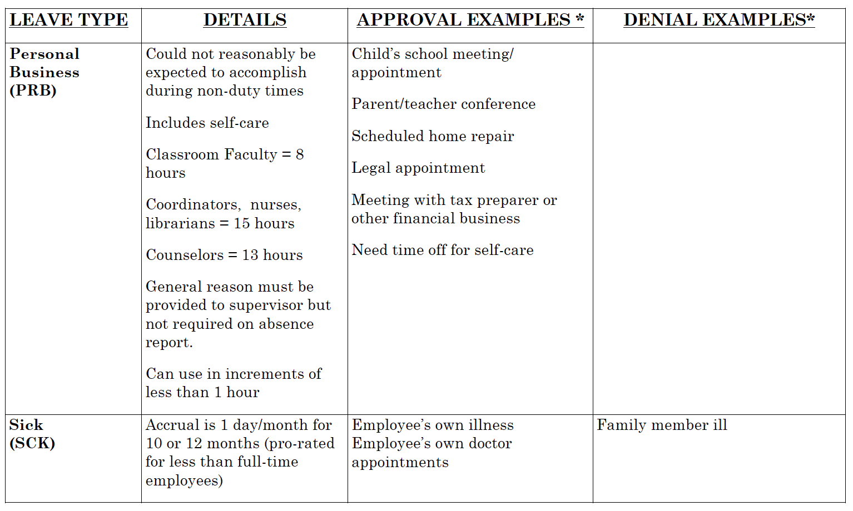
V. Other things about these leaves

Slide 24
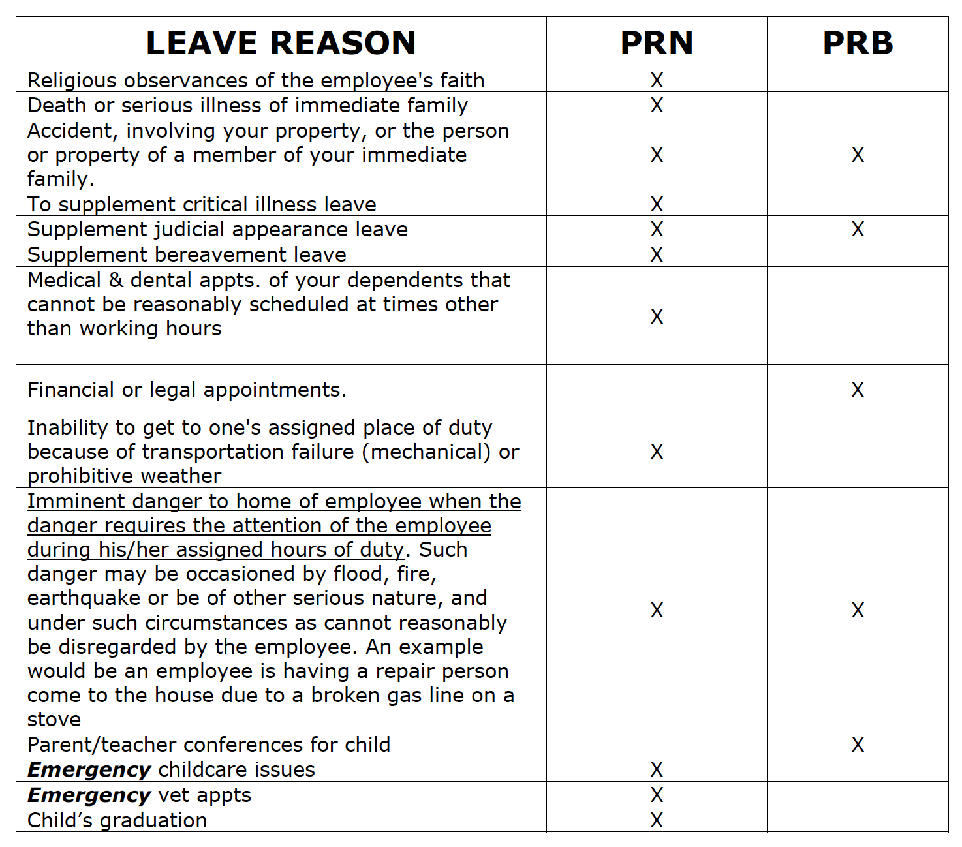
This table is old and doesn't list "personal care", but it does show Personal Necessity vs. Personal Business examples

Slide 25
Questions?

